Slide 1
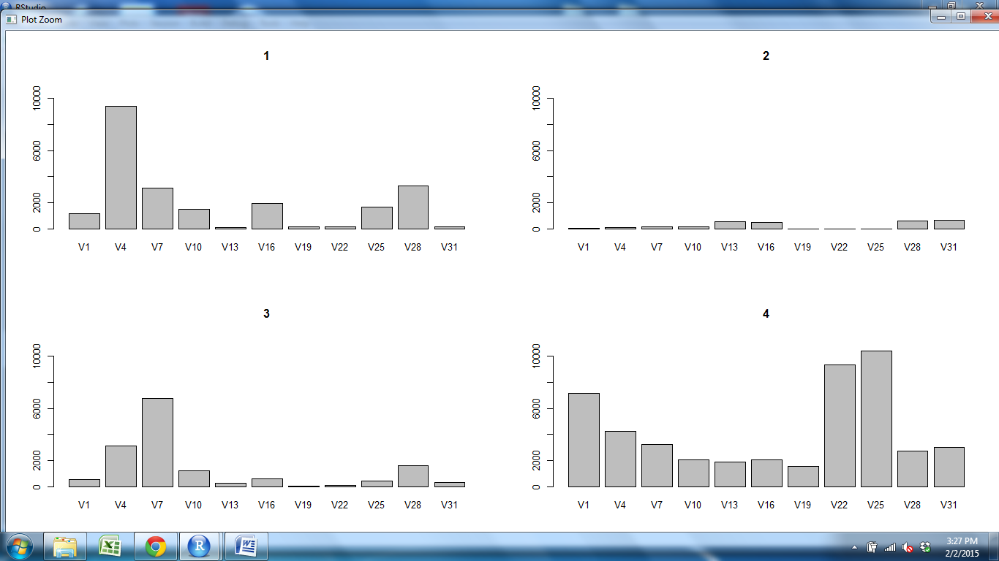
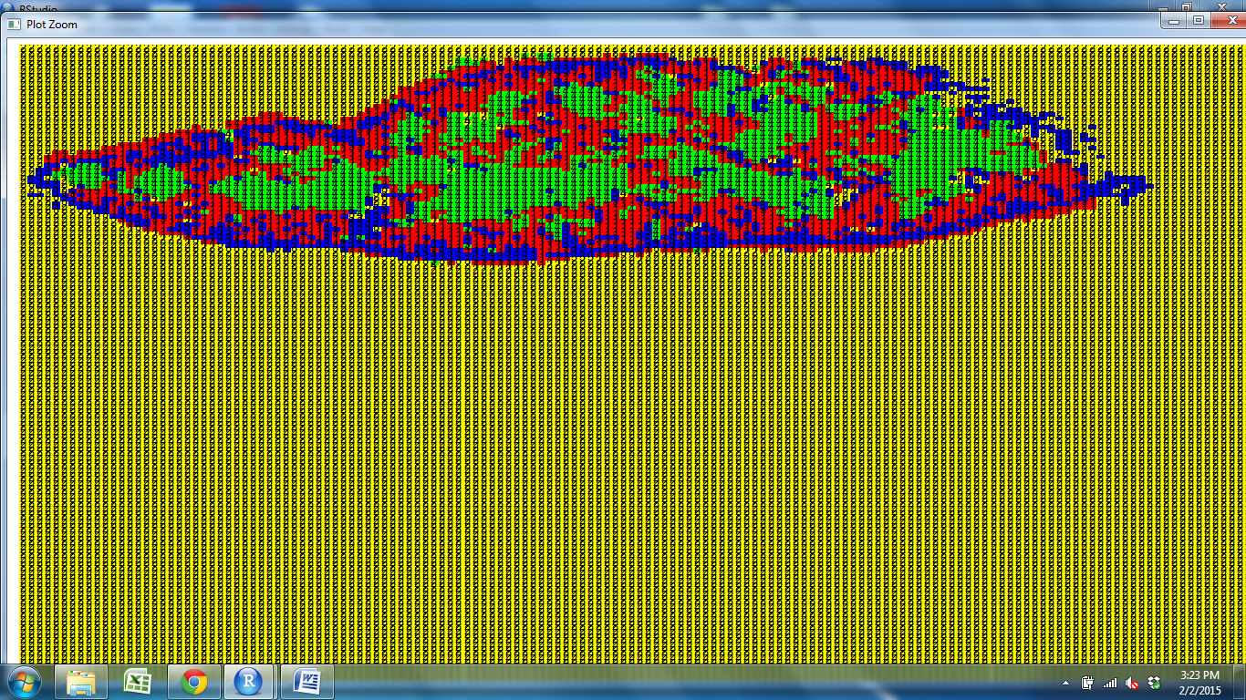
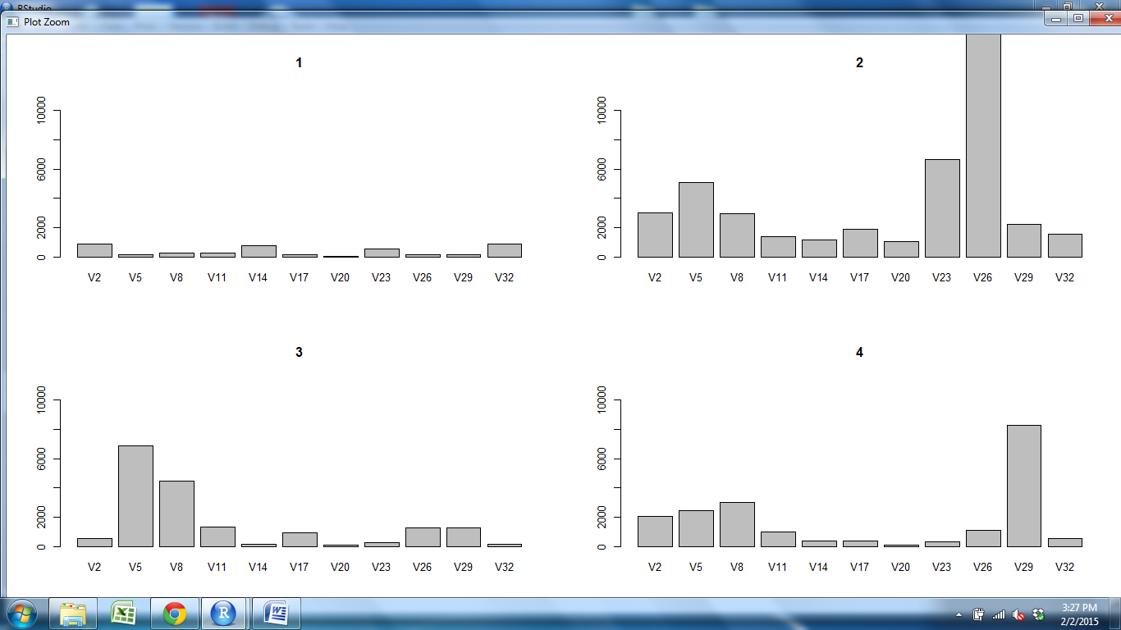
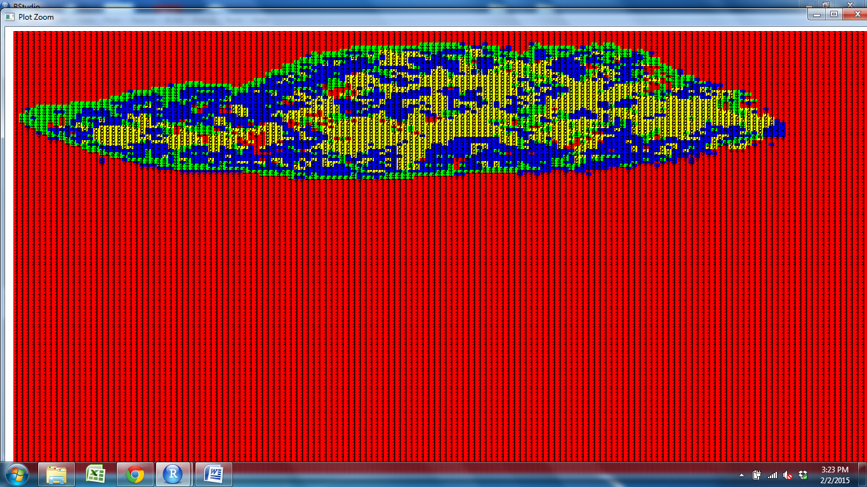
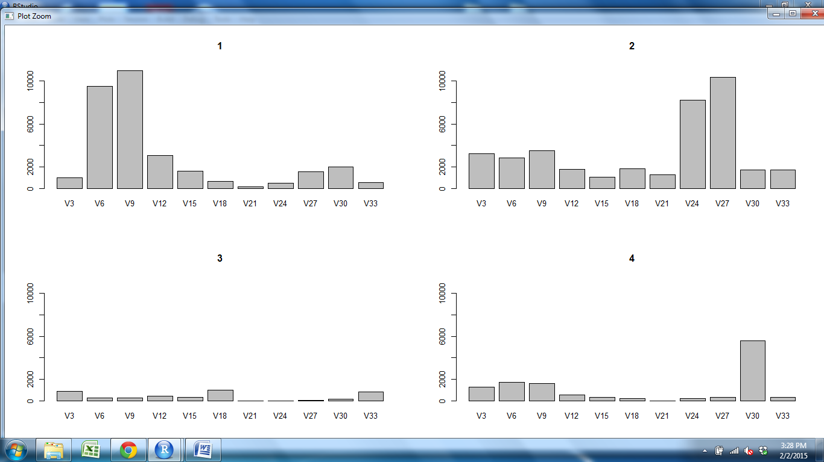
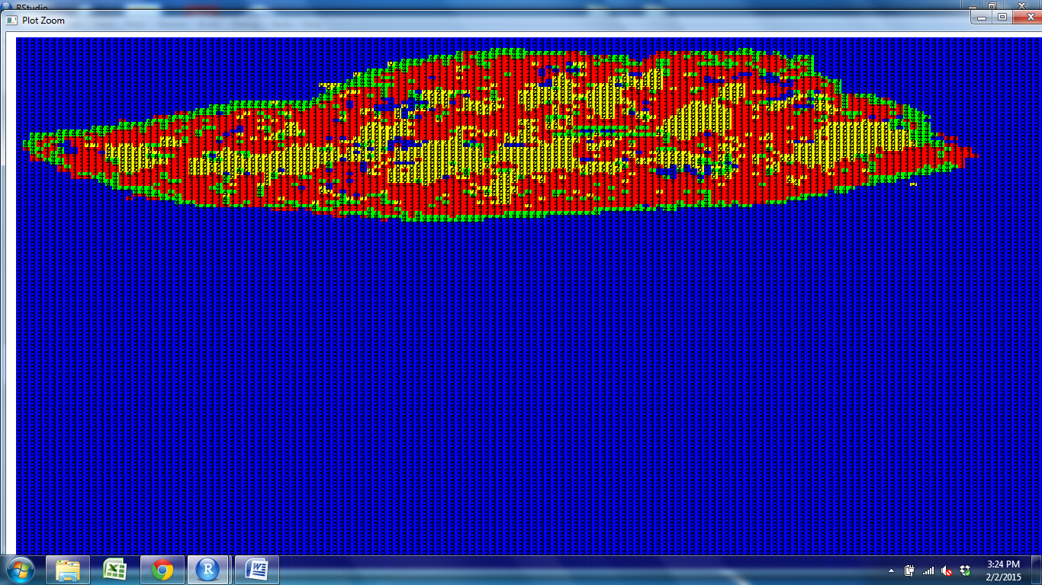
CD11c CD25 CD31 CD205 Claud5 Claud34 Foxp3 K5 K14 PDGFRb UEA1

Slide 2
CD11c CD25 CD31 CD205 Claud5 Claud34 Foxp3 K5 K14 PDGFRb UEA1

Slide 3
CD11c CD25 CD31 CD205 Claud5 Claud34 Foxp3 K5 K14 PDGFRb UEA1

Slide 4
CD11c CD25 CD31 CD205 Claud5 Claud34 Foxp3 K5 K14 PDGFRb UEA1

Slide 5
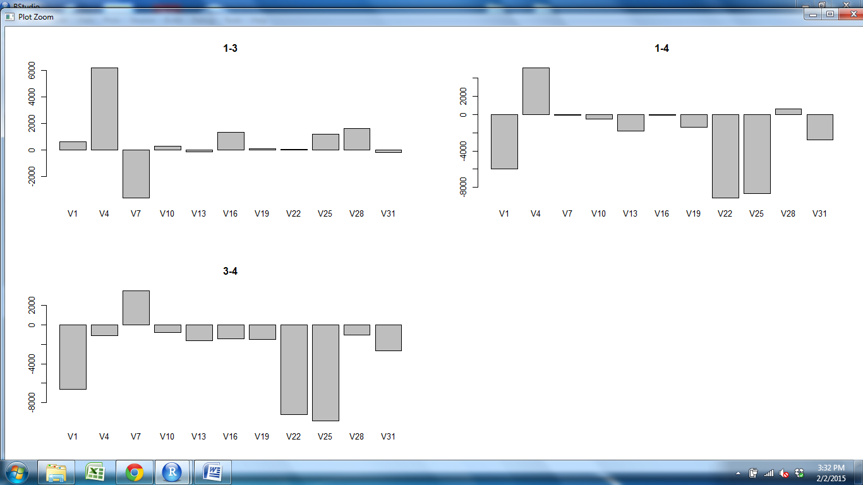
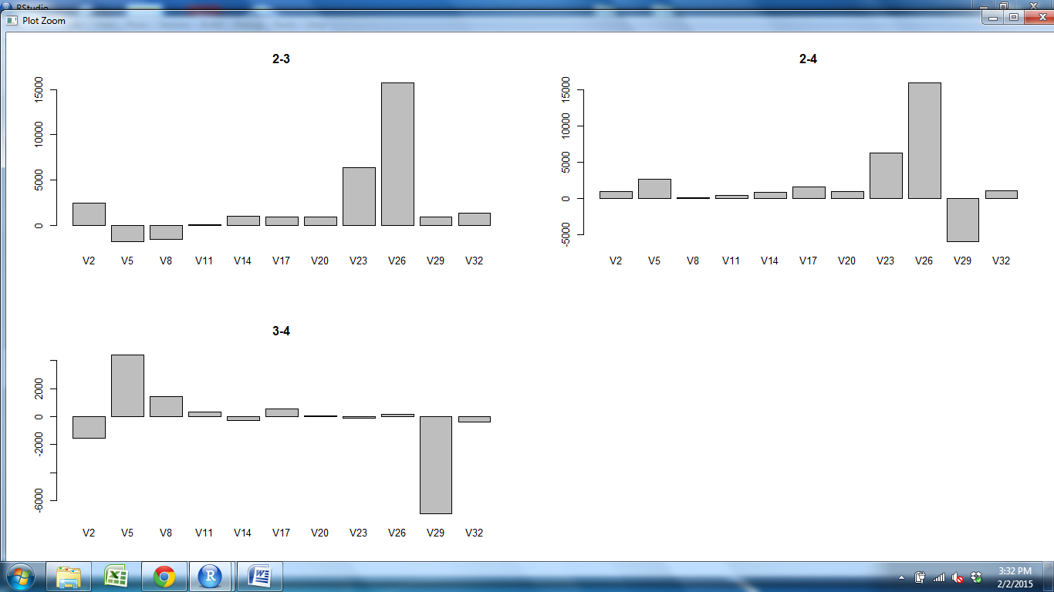
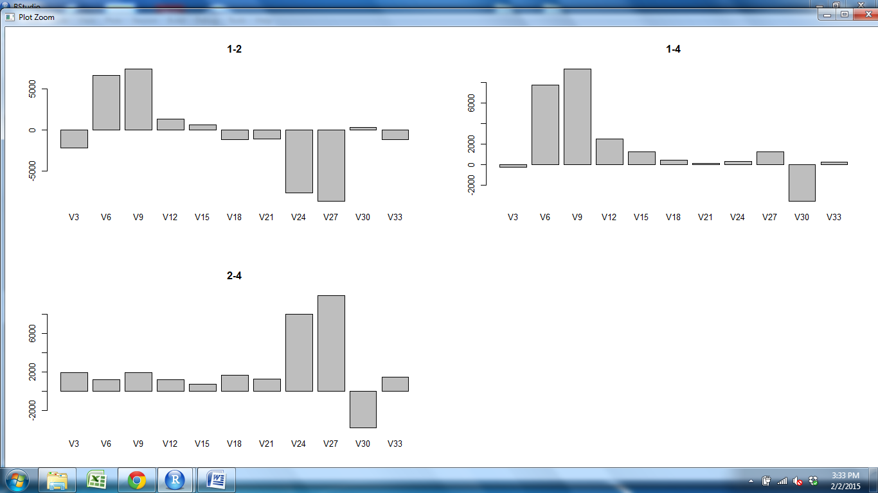
CD11c CD25 CD31 CD205 Claud5 Claud34 Foxp3 K5 K14 PDGFRb UEA1

Slide 6
CD11c CD25 CD31 CD205 Claud5 Claud34 Foxp3 K5 K14 PDGFRb UEA1

Slide 7
CD11c CD25 CD31 CD205 Claud5 Claud34 Foxp3 K5 K14 PDGFRb UEA1

Slide 8
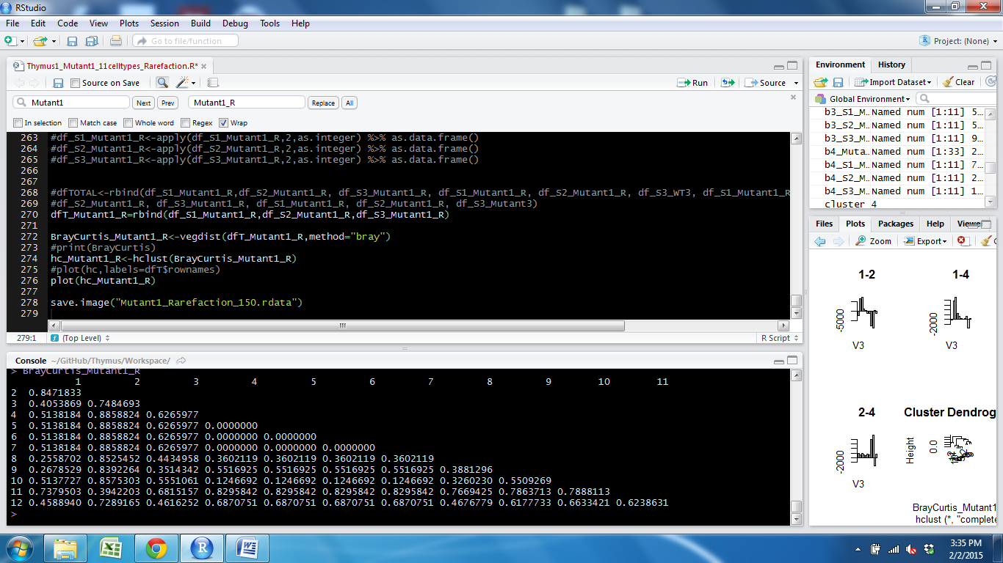
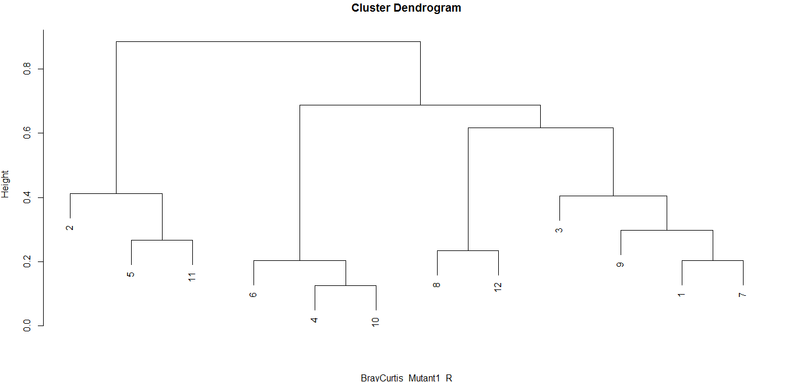
Mutant1 Norm 150
Subcap Cortex Outer M Outer M Cortex Subcap Cortex M Outer
Cortex
Outer
M
Outer
M
Cortex
Subcap
Cortex
M
Outer
Subcap
S1Cortex S2Outer S3Outer S2M S1M S2M S2Subcap S3Subcap S1Outer S3Cortex S1Subcap S2Cortex

